Slide 1
Survey of Digital Neuropsychological Assessment Technologies
Robert M. Bilder, PhD, ABPP-CN
Michael E. Tennenbaum Family Chair in Creativity Research, Chief of Medical Psychology – Neuropsychology, and Distinguished Professor of Psychiatry & Biobehavioral Sciences, Jane & Terry Semel Institute for Neuroscience and Human Behavior, Stewart & Lynda Resnick Neuropsychiatric Hospital, and David Geffen School of Medicine and Psychology, and College of Letters & Science at UCLA

Slide 2
Survey of Digital NP Assessment Technologies
Inertia in traditional NP assessment methods is profound
Potential for innovation based on technological advances and understanding of the brain is profound
While we continue to use traditional methods, new methods already are leveraging technology
How do we resolve this conflict and move forward as clinical neuropsychologists?
Focus on guidelines: FDA, AACN/NAN, APA
Survey what’s already out there…

Slide 3
“The Wechsler Adult Intelligence Scales, followed by the Wechsler Memory Scales, Trail Making Test, California Verbal Learning Test, and Wechsler Intelligence Scale for Children, were the most commonly used tests. These top five responses were identical and in the same order as those from 10 years ago” (page 206)
Archives of Clinical Neuropsychology 31 (2016) 206–230

Slide 4
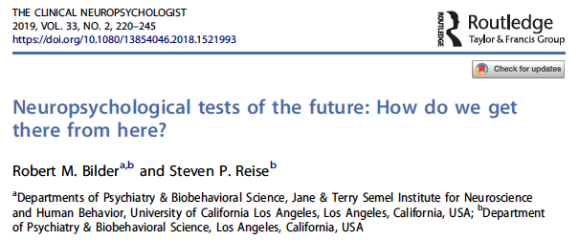

Slide 5
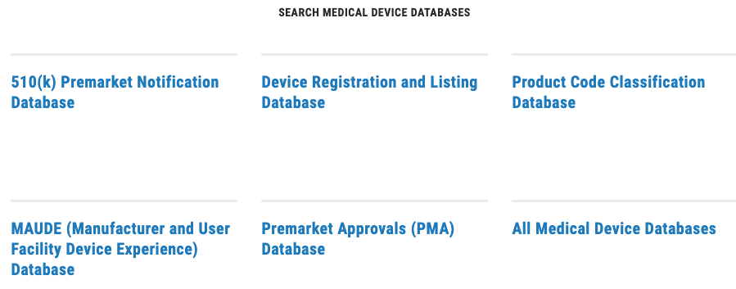

Slide 6
21 CFR Part 882 (Neurological Devices) 882.1470 Computerized cognitive assessment aid
FDA PRODUCT CODES
PKQ: https://www.accessdata.fda.gov/scripts/cdrh/cfdocs/cfPCD/classification.cfm?id=3787
PIW (EEG assesmt aid): https://www.accessdata.fda.gov/scripts/cdrh/cfdocs/cfPCD/classification.cfm?id=3783
PTY (exempt/PKQ)
https://www.accessdata.fda.gov/scripts/cdrh/cfdocs/cfPCD/classification.cfm?id=3798
POM (concussion)
https://www.accessdata.fda.gov/scripts/cdrh/cfdocs/cfPCD/classification.cfm?id=3792
Definition | The computerized cognitive assessment aid provides clinicians in a healthcare setting with objective measurements of cognitive function as a screening aid in the assessment of adults 55 years of age and older. This is done for the purpose of identifying a potential decline in cognitive function relative to baseline test performance of other age-normal adults, referring those adults for further testing where warranted, and monitoring changes in cognitive function over time
Physical State | Computer-administered battery of cognitive tests, computer keyboard, computer screen.
Technical Method | Uses a battery of objective cognitive tests delivered by computer software to determine an individual's current level of cognitive functioning.

Slide 7
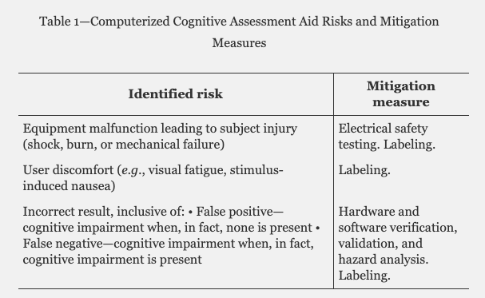

Slide 8
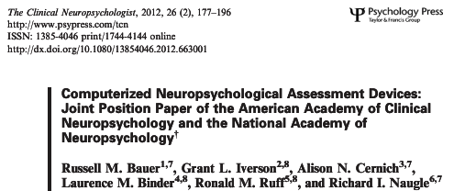
… position on appropriate standards and conventions for computerized neuropsychological assessment devices (CNADs).

Slide 9
AACN/NAN JOINT POSITION PAPER
These statements address:
device marketing and performance claims made by developers of CNADs;
issues involved in appropriate end-users for administration and interpretation of CNADs;
technical (hardware/software/firmware) issues;
privacy, data security, identity verification, and testing environment;
psychometric development issues, especially reliability and validity;
cultural, experiential, and disability factors affecting examinee interaction with CNADs;
use of computerized testing and reporting services; and
the need for checks on response validity and effort in the CNAD environment.

Slide 10
AACN/NAN JOINT POSITION PAPER
CNADs can be appropriately administered by paraprofessionals or technically trained staff…
BUT
The safe and competent use of CNADs requires a link to professionals trained in the use of psychometric techniques in the differential diagnostic setting.

Slide 11
Part I: Test Construction, Evaluation, and Documentation
1. Validity 2. Reliability and Errors of Measurement 3. Test Development and Revision 4. Scales, Norms, and Score Comparability 5. Test Administration, Scoring, and Reporting 6. Supporting Documentation for Tests
Part II: Fairness in Testing
7. Fairness in Testing and Test Use 8. The Rights and Responsibilities of Test Takers 9. Testing Individuals of Diverse Linguistic Backgrounds 10. Testing Individuals with Disabilities
Part III: Testing Applications
11. The Responsibilities of Test Users 12. Psychological Testing and Assessment 13. Educational Testing and Assessment 14. Testing in Employment and Credentialing 15. Testing in Program Evaluation and Public Policy

Slide 12
Some Digital Platforms for NP Assessment*
CANTAB Mobile and CANTAB insight**
CNS Vital Signs**
CogniFit**
Cogstate
Lumosity NeuroCognitive Performance Test**
NeuroTrax**
Philips’ IntelliSpace Cognition**
Digital MOCA
BrainCheck
Amsterdam Cognition Scan
Q-interactive
Food for the Brain
Cognivue
TabCat
NIH Toolbox
TestMyBrain
Concussion Specific
ImPACT
Banyan BTI
BrainScope Company, Inc.
InfraScan
Oculogica, Inc.
*We are not aware of any resource specifying how widely any of these is used; selection by WOMBAT*** strategy.
Underlined vendors were sent a list of questions; **these vendors responded.
***Word of mouth by actually talking

Slide 15
CANTAB Mobile, CANTAB Insight
CANTAB legacy via Trevor Robbins, Barbara Sahakian, decades of research
Mobile focuses on memory, depression, older adults; Insight also younger
CANTAB Mobile has normative data for ages 50 through 90 while CANTAB Insight has normative data for ages 18 through 90
Self-administered with built-in voiceover instructions in 22 languages
Reports are intended for the clinicians
Norms on ~7000 people
Validity?: “There is extensive, published research data on these parameters for all the cognitive tests included in the batteries: https://www.cambridgecognition.com/community/bibliography” (search on ‘Dementia’ yields 218 papers)

Slide 17
CNS Vital Signs
CNSVS and “Concussion” product lines
10 neurocognitive tests and over 50 scales such as PHQ9
CNSVS 5 to 60+ minutes (flexible; avg 36 min); Concussion < 30 min
Local and internet versions
Expect FDA clearance within the year
Norms on 1569 people ascertained 2004-2006
128 factorial forms/retest
PubMed bibliography provided with 87 publications

Slide 18
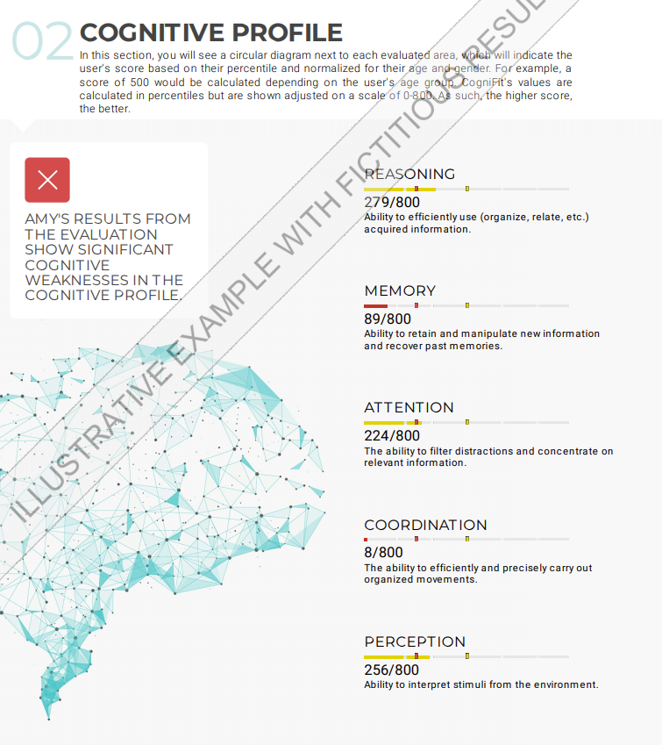
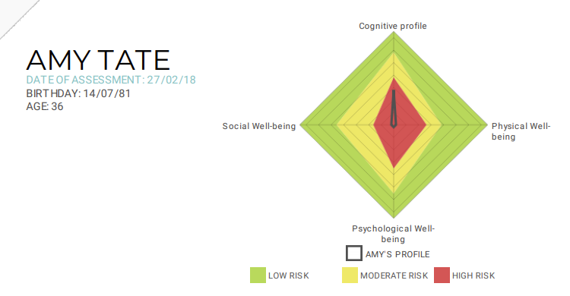
COGNIFIT

Slide 19
CogniFit
3 Well being indicators and 22 cognitive skills (included in 5 cognitive domains); On-line via computer, tablet or phone
Time: Min: 30 minutes; Average: 45 minutes; Max: more than 1 hour for people with TBI for example
CogniFit assessments tools have no indication that are or should be considered a Medical Device by the FDA
Reliability: Alpha range .57-.89, most > .7; test-retest most > .8
Validated re: CANTAB, Ravens, WCST, CPT, Stroop, reading tests
Normative data: not clear

Slide 21
Lumosity NeuroCognitive Performance Test
Modular, up to 17 assessments in 5 domains. 15-35 minutes
Had initial meetings with FDA to discuss 510k clearance
Do not sell NCPT: it’s for researchers and free to subscribers
Consumer product provides only raw measures
Published on 130,140 English-speaking Ss studied 2013-15, age 13-89, healthy by self report (Morrison et al., 2015)
Inter-test correlations (8 tests) range from .19 to .52. Test-retest .39 to .83 for “Grand Index”; more info on age effects
Corrs with P&P tests: .47 to .71

Slide 22
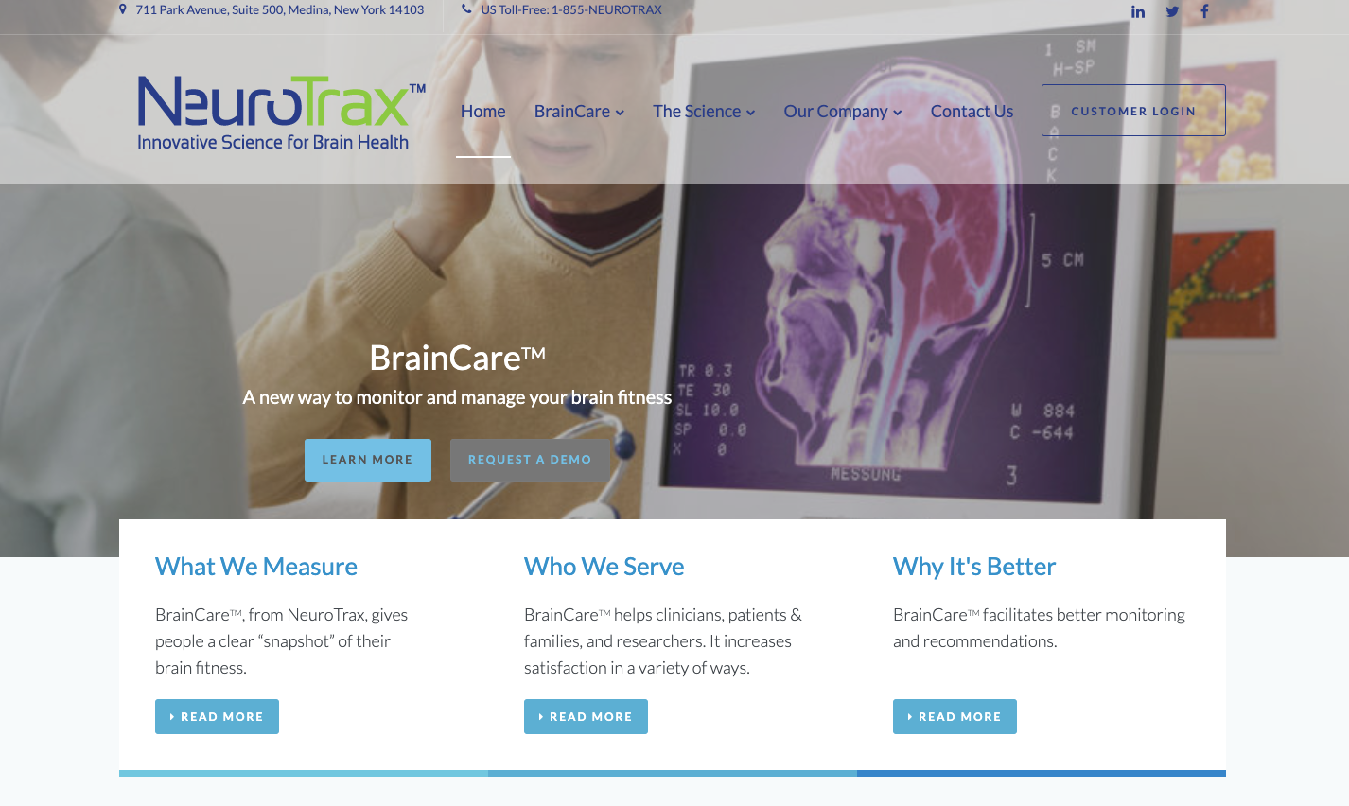

Slide 23
NeuroTrax
Global and up to 7 domains; most comprehensive has 10 tests and produces 78-113 individual test scores; average 45 to 60 minutes.
“NeuroTrax is an assessment tool and not a diagnostic one, NeuroTrax has not found it necessary to seek FDA approval of any kind”
Windows/PC (desktop, tablet); usually admin in clinical setting. Test Supervisor must be certified following completion of online (80 min) training course; then interpreted by clinician
Norms on N=1569 age 20-80, stratified on by age, education, collected 2002-2006.
Alpha .65-.96; alt form reliability .59-.92; predicted conversion MCI-Dementia 89% w/ NT vs 66% w/ Lawton IADL. Comparison to P&P with correlations from .5 to .91

Slide 24
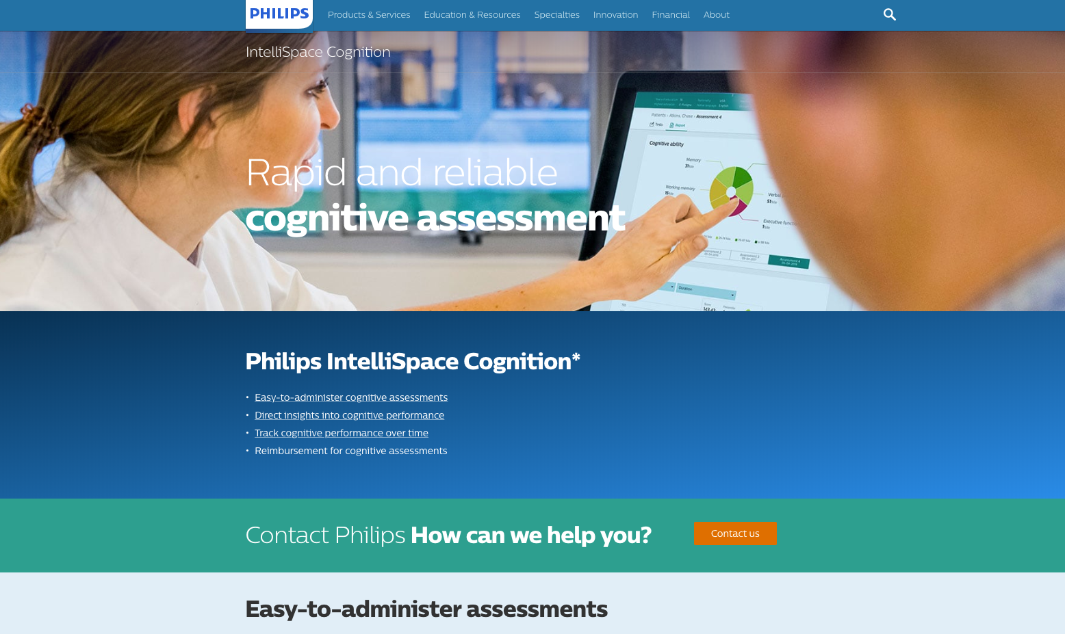

Slide 25
Philips’ IntelliSpace Cognition
Approx 15 test scores, mapping to 6 domains based on factor analysis, 30-40 min
FDA Q1 2020 882.1470
Clinician office iPad, supervised tech, interp by licensed clinician, focus on neurologist/neuropsych
Validation and norming ongoing; PI James Holdnack
Sample size: 300
All tests are digital variants of paper tests; validation compares digital to paper in norm group (Clock, ROCFT, TMT, Cancellation…)
Integration of neuroimaging and EEG will be offered

Slide 26
Conclusions
Market is large
Vendors entering marketplace, most to clinician’s office
Distinction between ‘screening’ and ‘assessment’ not clear
Training variable
Theoretical and practical models for tests variable
Normative studies variable
Psychometric studies variable but generally limited
Validation studies variable but generally limited
Next? Set standards – follow-up on AACN/NAN position paper?

Slide 27
Many thanks!
Consortium for Neuropsychiatric Phenomics (52 investigators); Investigators in current RDoC projects, and Whole Genome Sequencing in Psychiatric Disorders (WGSPD; Freimer et al.). Special thanks to Steve Reise, Catherine Sugar, Gerhard Helleman, Ariana Anderson, and Max Mansolf for measurement issues, and to the NNN PIs: Rus Bauer, Dan Drane, David Loring, Lauren Umfleet, and Dustin Wahlstrom.
Supported by NIH Grants: (CNP) UL1-DE019580, RL1MH083268, RL1MH083269, RL1DA024853, RL1MH083270, RL1LM009833, PL1MH083271, and PL1NS062410; (Cognitive Atlas) RO1NS061771; (Multilevel WM/RDoC) R01MH101478; (Modeling/RDoC) R03MH106922; (WGSPD) U01 MH105578; R01MH (NATIONAL NEUROPSYCHLOGY NETWORK).
rbilder@mednet.ucla.edu
http://www.semel.ucla.edu/creativity
http://healthy.ucla.edu
Notes:
So
I hope you’ll write.
Thank you.

Slide 28
Please write or call!
William B. Barr, PhD, ABPP-CN
NYU-Langone Comprehensive Epilepsy Center
223 East 34th Street
New York, NY 10016
646-558-0809
william.barr@nyulangone.org
Robert M. Bilder, PhD, ABPP-CN
UCLA Semel Institute for Neuroscience & Human Behavior
740 Westwood Plaza
Los Angeles, CA 90024
310-825-9474
rbilder@mednet.ucla.edu
Justin B. Miller, PhD, ABPP-CN
Cleveland Clinic Lou Ruvo Center for Brain Health
888 W. Bonneville Ave.
Las Vegas, NV 89106
702-701-7896
millerj4@ccf.org
Travis Millman
Strategic Advisor
Digital Cognitive Diagnostics
Philips HealthWorks
2 Canal Park, 3rd Floor
Cambridge, MA 02141
(917) 496-3663
travis.millman@philips.com

Slide 29
Supplementary Material

Slide 30
§882.1470 Computerized cognitive assessment aid.
(a) Identification. The computerized cognitive assessment aid is a prescription device that uses an individual's score(s) on a battery of cognitive tasks to provide an interpretation of the current level of cognitive function. The computerized cognitive assessment aid is used only as an assessment aid to determine level of cognitive functioning for which there exists other valid methods of cognitive assessment and does not identify the presence or absence of clinical diagnoses. The computerized cognitive assessment aid is not intended as a stand-alone or adjunctive diagnostic device.
…

Slide 31
§882.1470 Computerized cognitive assessment aid (cont…)
(3) The labeling must include:
(i) A summary of any testing conducted to demonstrate how the device functions as an interpretation of the current level of cognitive function. The summary of testing must include the following, if available: Any expected or observed adverse events and complications; any performance measurements including sensitivity, specificity, positive predictive value (PPV), and negative predictive value (NPV) per the devices intended use; a description of the repeatability of measurements; a description of how the cut-off values for categorization of measurements were determined; and a description of the construct validity of the device.
(ii) A warning that the device does not identify the presence or absence of clinical diagnoses.
(iii) A warning that the device is not a stand-alone diagnostic.
(iv) The intended use population and the intended use environment.
(v) Any instructions technicians must convey to patients regarding the administration of the test and collection of cognitive test data.
[80 FR 49138, Aug. 17, 2015]

Slide 32
§882.1471 Computerized cognitive assessment aid for concussion.
(a) Identification. …in response to concussion.
….
(ii) Evaluate device test-retest reliability of the device output.
(iii) Evaluate construct validity of the device cognitive assessments.
(iv) Describe the construction of the normative database, which includes the following:
(A) How the clinical workup was completed to establish a “normal” population, including the establishment of inclusion and exclusion criteria.
(B) Statistical methods and model assumptions used.
(3) The labeling must include:
(i) A summary of any clinical testing conducted to demonstrate how the device functions as an interpretation of the current level of cognitive function in a patient that has recently received an injury that causes concern about a possible concussion. The summary of testing must include the following:
[81 FR 87811, Dec. 6, 2016]

Slide 33
Questions for Vendors - 1
How many primary measures are generated by your battery (composite, individual domain, individual test scores)?
How long does it take (min, max, average)?
Is your system registered with the FDA or another agency?
How much does it cost? (and is the model price per patient, or do you sell a package for unlimited use?)
In what setting/device/supervision is it administered? Clinician’s office, home? Local device or On-Line? Computer, Tablet, or Phone?
Supervised by clinician/tech or do-it-yourself?

Slide 34
Questions for Vendors - 2
Who uses the information/reports? Licensed clinician (MD, PhD, other?) or direct-to-consumer/patient? If a clinician, do you focus on a particular provider type (primary care, neurologist, psychologist, nurse, other…). If reports are DTC, what are the recommendations made (are examinees directed to specific resources?)?
What normative standardization data do you have? When was standardization done (if ongoing, what is the approach over time)? What is the sample size? What are the sample characteristics? Age, Sex, Education, Language, Race, Ethnicity, other demographics? If done on line, how were examinees authenticated?

Slide 35
Questions for Vendors - 3
What psychometric data do you have on each of the primary measures? (Internal consistency, Test-retest reliability, Alternate forms reliability, IRT parameters)
What external validity data do you have? Age effects? Correlations with other widely used neuropsychological tests?
What clinical validity data do you have? Differential diagnostic data: what diagnosis vs what comparison group? Group discrimination statistics?
Predictive validity of key outcomes?
How is performance validity assessed? Are there embedded effort measures? Stand alone effort measures?
For automated/on-line/unsupervised acquisition, how does the test determine understanding of instructions?
Any other comments about your battery?

